Slide 1
Tooth Preparation for silver amalgam restorations

Slide 3
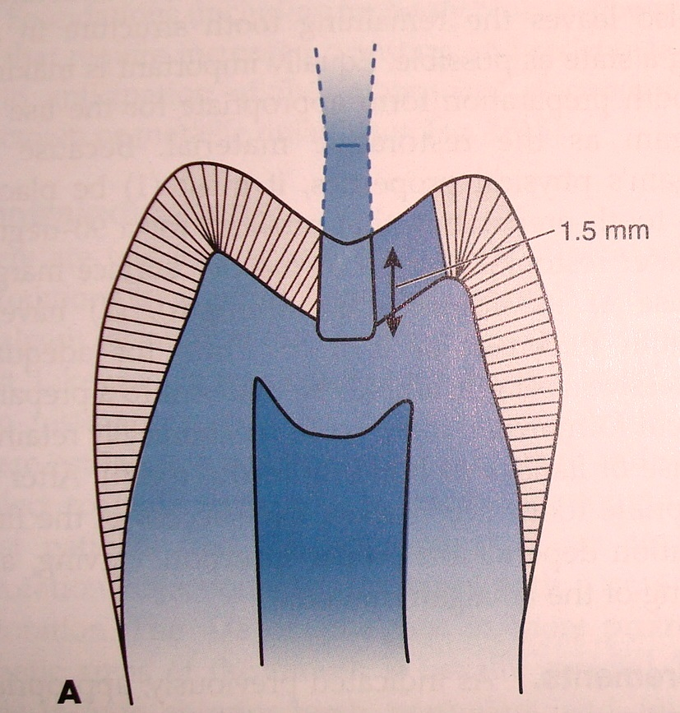

Slide 4
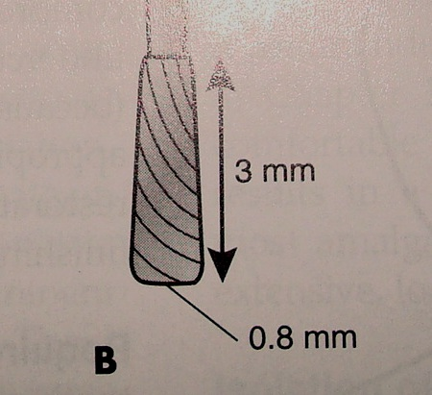

Slide 5
INITIAL DEPTH

Slide 6
OUTLINE FORM FOR MANDIBULAR FIRST MOLAR

Slide 7
Outline Form
Establishing outline form means:
1) Placing preparation margins in positions they will occupy in the final preparation except for finishing enamel walls and margins.
2) Preparing an initial depth of 0.2 to 0.8mm pulpally of the DEJ position.

Slide 8
Principles
1) All friable or weakened enamel should be removed
2) All faults should be included
3) All faults should be placed in a position to afford good finishing of margins of the margins.

Slide 9
Features
1) Preserving cuspal strength
2) Preserving marginal ridge strenth
3) Minimising faciolingual extensions
4) Using enameloplasty
5) Connecting two close lesions (<0.5 mm ) apart
6) Restricting depth of preparation to 0.2mm for pit & fissure caries/ 0.8 mm for smooth surface lesions.

Slide 10
For Pit & Fissure Lesions
Three factors:
1) Extent to which enamel is involved by the carious process
2) Extensions that are to be made along fissures to achieve sound and smooth margins.
3) Limited bur depth from external walls is 1.5-2mm and 0.2 mm into dentin.

Slide 11
Rules for pit & fissure caries
1) Preparation should be extended to sound margins
2) Avoid terminating margins on cusp heights or ridge crests.
3) If extension from primary groove includes ½ or more of cusp incline, cusp capping should be considered. If 2/3 rd, cusp capping should be done.
4) All the fissures which cannot be eliminated by enameloplasty should be included in the prepn.

Slide 12
5) Depth at central pit should be 1.5mm, 0.2- 0.5mm into dentin, 2mm from external surfaces.
6) Close lesions (<0.5 mm apart) should be joined.

Slide 13
Rules for outline form for smooth surface lesions
1) Extend margins to sound tooth structure
2) Avoid terminating on cuspal eminences.
3)Restrict axial wall pulpal depth to a maximum of 0.2 to 0.8mm . The bur is held parallel to DEJ cutting 0.3 mm into enamel and 0.5 mm into dentin
4) The gingival margins are extended apically of proximal contact to provide a minimum clearnce of 0.5 mm between gingival margin and adjacent tooth.

Slide 14
PULPAL DEPTH
Variance in pulpal depth-a. At minimal gingival extension.
b. At moderate extension.
c. At extension that places gingival margin at cementum.

Slide 15
Auxillary factors for outline form
Conservation
Adjacent enamel cracks.(crazing) or decalcificationscould be involved in the preparation.
Type of restorative material.
Extension for access.
Unusual anatomy.
Margins should be in occlusion with opposing teeth.
Aesthetics.
Protcection of critical anatomy.

Slide 16
Continued.
Abnormal cleansing capability.-abnormal saliva,mental retardation or physical handicaps.
Use of enameloplasty and enamectomy.
Extension for retention.
Extension for resistance.

Slide 17
CUSP CAPPING

Slide 18
Enameloplasty
If one third or less of the enamel is involved, the fissure may be removed by enameloplasty without preparing or extending the tooth preparation.
It is also indicated in a shallow fissure that approaches or crosses a facial or lingual ridge

Slide 19
ENAMELOPLASTY

Slide 20
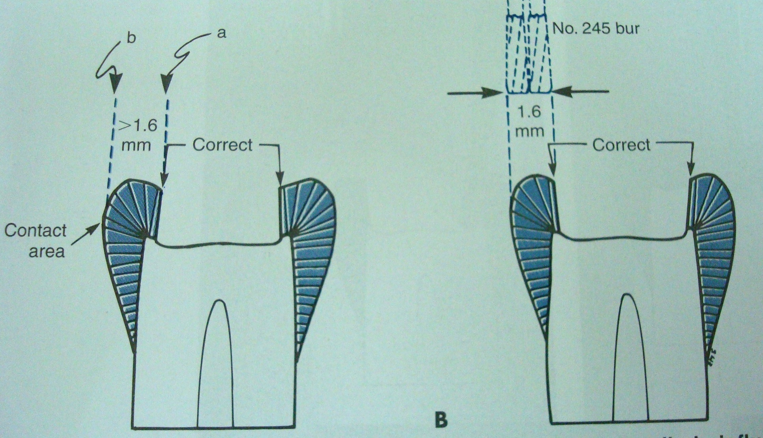

Slide 21
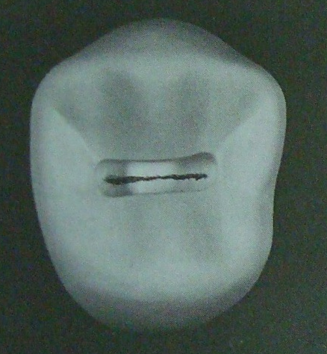

Slide 22
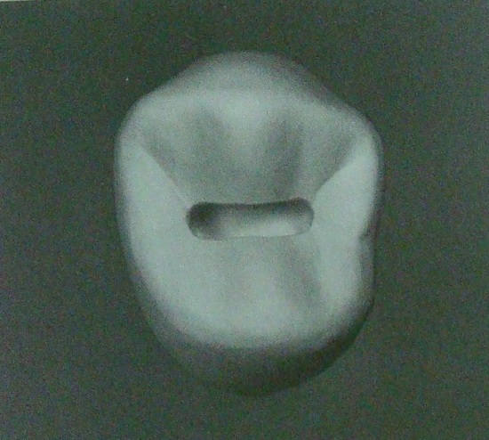

Slide 23
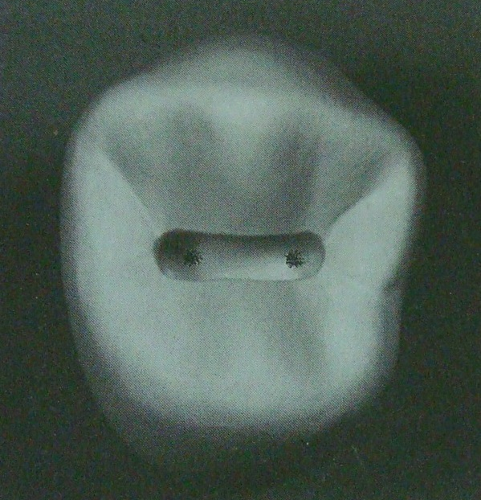

Slide 24
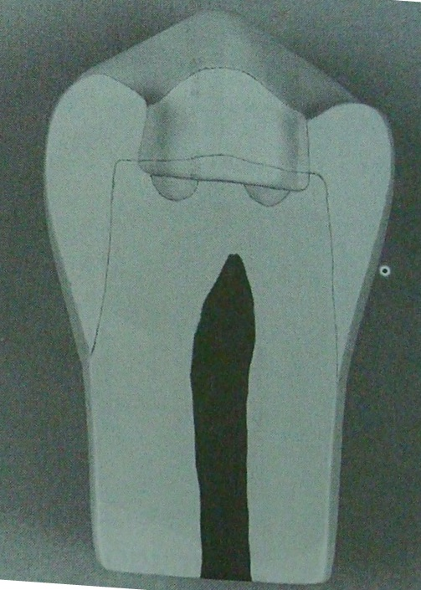

Slide 25
Primary Resistance Form
It is the shape and placement of the preparation walls that best enable the restoration and the tooth to withstand , without fracture, masticatory forces delivered principally in the long axis of the tooth.
To restrict the extension of the external walls to allow strong cusp and ridge areas to remain with sufficient dentin support.

Slide 26
To have a slight rounding (coving) of internal line angles to reduce stress concentrations in tooth structure
To cap cusps and include enough of a weakened tooth within the restoration in extensive tooth preparations.
To provide enough thickness of restorative material to prevent its fracture under load.
To bond the material to tooth structure when appropriate.

Slide 27
Rounding of external line angles (eg. Axiopulpal line angles) reduces the stress on some restorative materials (amalgam and porcelain), increasing resistance to fracture of the restorative material.
The minimum thickness for amalgam is 1.5mm, 1-2mm for cast metal and 2mm for porcelain.

Slide 28
Stress patterns of teeth Anterior teeth
Junction between clinical crown and clinical root.

Slide 29
The incisal angles, are subject to tensile and shear stresses.

Slide 30
The axial angles and lingual marginal ridges bear more shear stresses.

Slide 31
The distal surface of cuspid exhibits unique pattern as iut is the junction of anterior and posterior segments of the arch.

Slide 32
Resistance form
To best resist masticatory forces use floors or planes at right angles to direction of loading.

Slide 33
Resistance form
If possible,walls of preparation should be parallel to direction of loading.
Definite line angles,point angles ae necessary to prevent micromovements.

Slide 34
Resistance form
Increasing the bulk of a restorative material or leaving sufficient bulk of tooth structure in critical areas will decrease stress per unit volume.

Slide 35
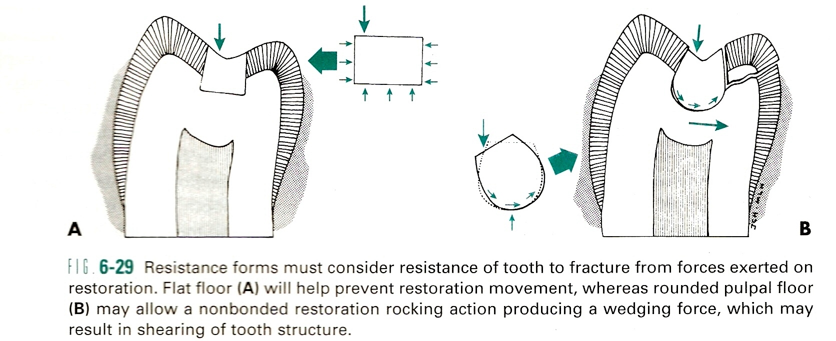

Slide 36
Fcators affecting resistance form
Assessment of occlusal contact: on the restoration and remaining tooth structure.
The greater is occlusal force, greater is the potential to fracture.
Amount of remaining tooth structure: Larger teeth, less prone to frcature even though extensively involved.

Slide 37
The type of restorative material
Bonding of material to the tooth.

Slide 38
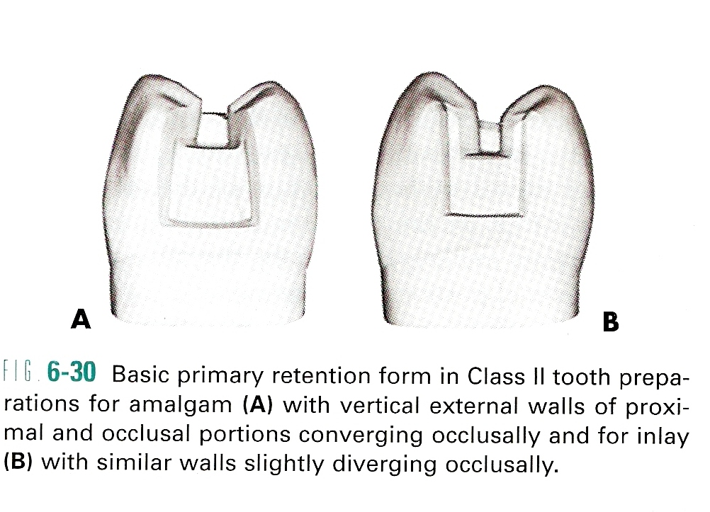

Slide 39
Primary retention form is the shape or form of the conventional preparation that resists displacement or removal of the restoration by tipping or lifting forces.
For amalgam Class I and II preparations , the material is retained in the tooth by developing external tooth walls that converge occlusally.

Slide 40
Composites restorations primarily are retained in the tooth by a micromechanical bond that develops between the material and etched and primed prepared tooth structure.
Cast metal (usually a gold alloy) intracoronal restorations rely primarily on almost parallel walls to provide retention.
A small degree of divergence (2-5 degrees per wall ) from the line of draw that would enhance retention form.

Slide 41
The greater the vertical height of the walls, the more divergence is permitted.
Close parallelism of prepared walls is a principal retention for cast metal restoration, other being the use of luting agent that bonds to the tooth structure.
In class II preparations an occlusal dovetail may aid in preventing the tipping of the restoration by occlusal forces.

Slide 42
Additional Factors for retention form
(1)Frictional retention.
(a)surface area of contact between wall and restorative material.
(b)opposing walls involved.
(c )parallelism of walls
(d)proximity of material and tooth structure.

Slide 43
Frictional retention

Slide 44
Changing the position of dentinal walls and floors microscopically by using condensation energy within the dentin’s proportional limit can add more gripping action by the tooth on restorative material.
This occurs when to dentin regains its original position while the restorative material rigid, thereby completely obliterating any remaining space in the cavity preparation.

Slide 45
Elastic deformation of dentin.

Slide 46
MCQs
Q 1. Initial depth for class I cavity is
A. 0.2-0.5 mm into DEJ
B. 0.5-0.8 mm into DEJ
C. 0.8-1.00 mm into dentin
D. > 1 mm into dentin.

Slide 47
Q. 2 Two carious lesions should be joined when distance between them is:
A. More than 0.5 mm
B. Less than 0.2mm
C. More than 0.2mm
D. Less than 0.5 mm

Slide 48
Q. 3 Clearance between two adjacent teeth should be
A. 0.2mm
B. 0.3mm
C. 0.4mm
D. 0.5mm

Slide 49
Q.4 Enameloplasty is done when
A. less than ½ enamel depth is involved
B. less than 1/3 of enamel depth is involved
C. more than ½ enamel depth is involved
D. more than 1/3 of enamel depth is involved.

Slide 50
Q. 5 Resistance form dependes on
A. Bulk of restorattion
B. Convergindg walls
C. Dovetail
D. width

